Slide 1
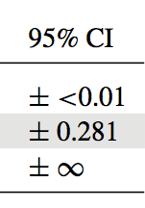

Measurement error, identifiability, and model adequacy
Brian O’Meara http://www.brianomeara.info @omearabrian

Slide 2
Learning objectives
Be afraid
Be very afraid
Figure out how to deal with this
Also, measurement error. Let’s start with that….

Slide 3
Measurement error
Darwin’s great insight was that variation is widespread in nature, even within species
In comparative methods…. we’re getting there
There is variation within species
There is also uncertainty in measurements for a given individual
Giant squid length, tree height, primate socialization frequency, leaf nitrogen, etc.

Slide 4

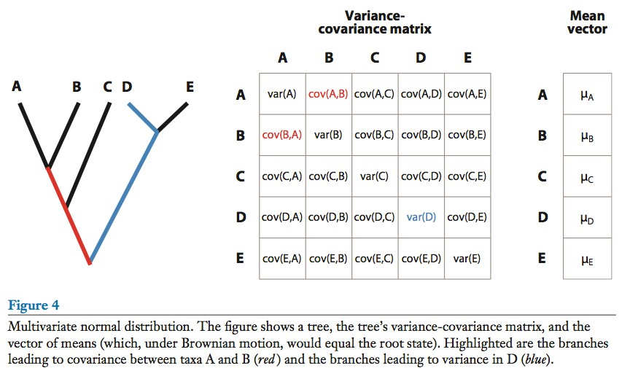

O’Meara 2012

Slide 5
+ error
+ error
+ error
+ error
+ error
O’Meara 2012

Slide 6


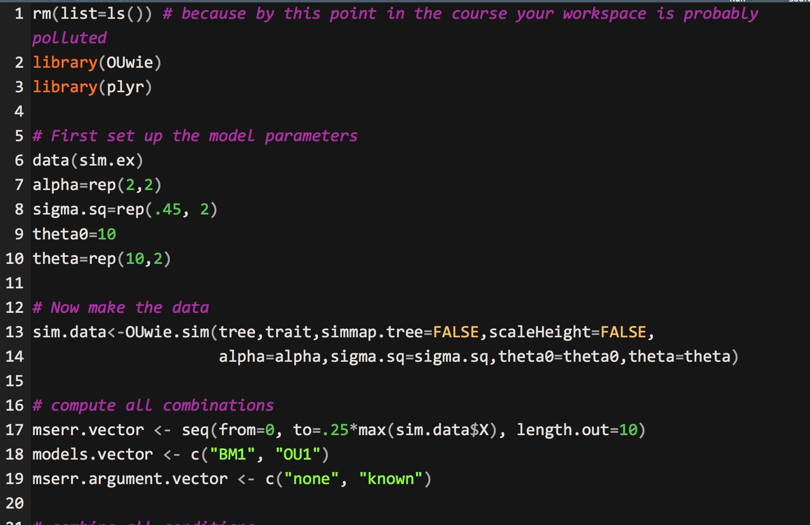
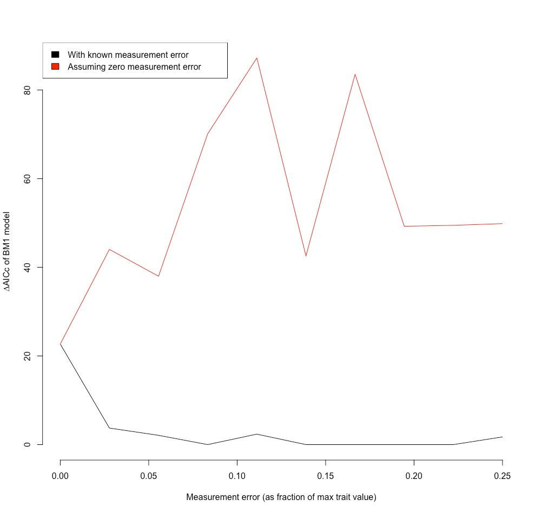
Does this matter? Exercise interlude…

Slide 7
Identifiability
x + y = 5
What is x?

Slide 8
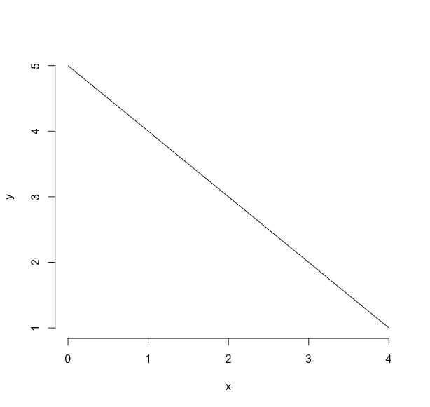
x + y = 5

Slide 9
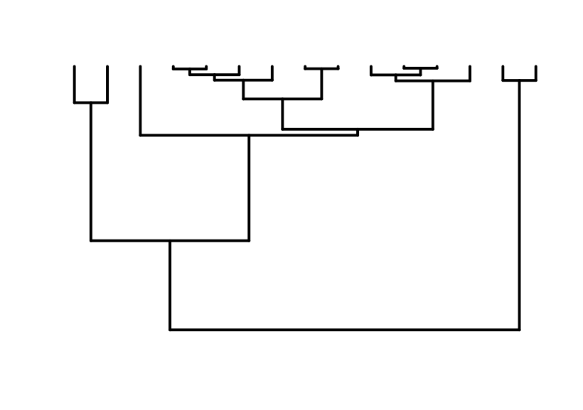

OU: optimum µ
Ancestral state y₀

Slide 10
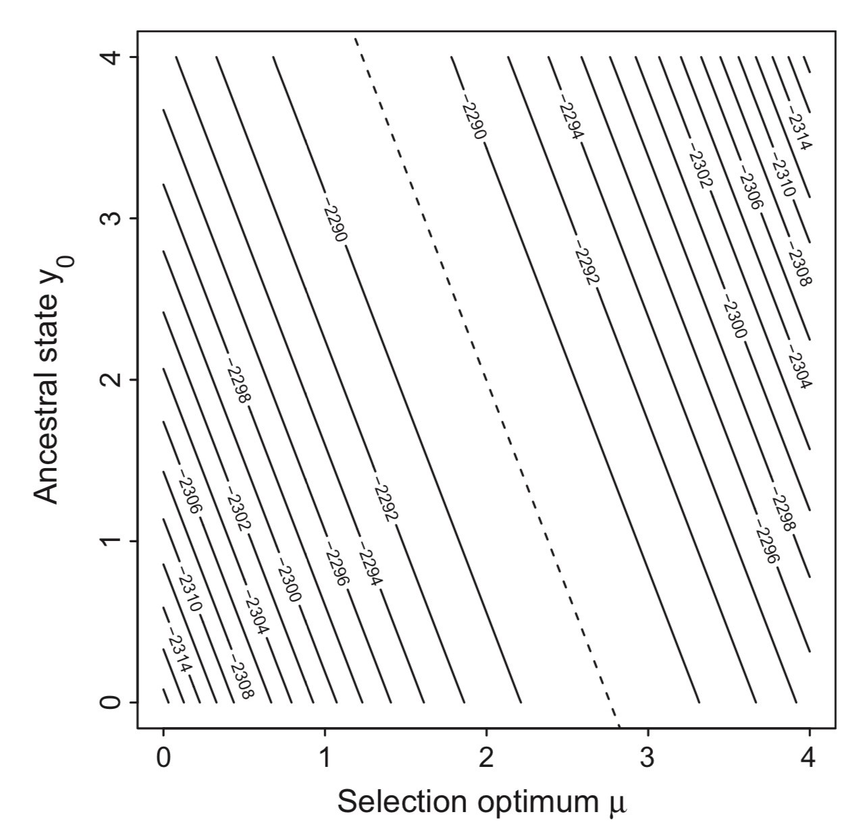
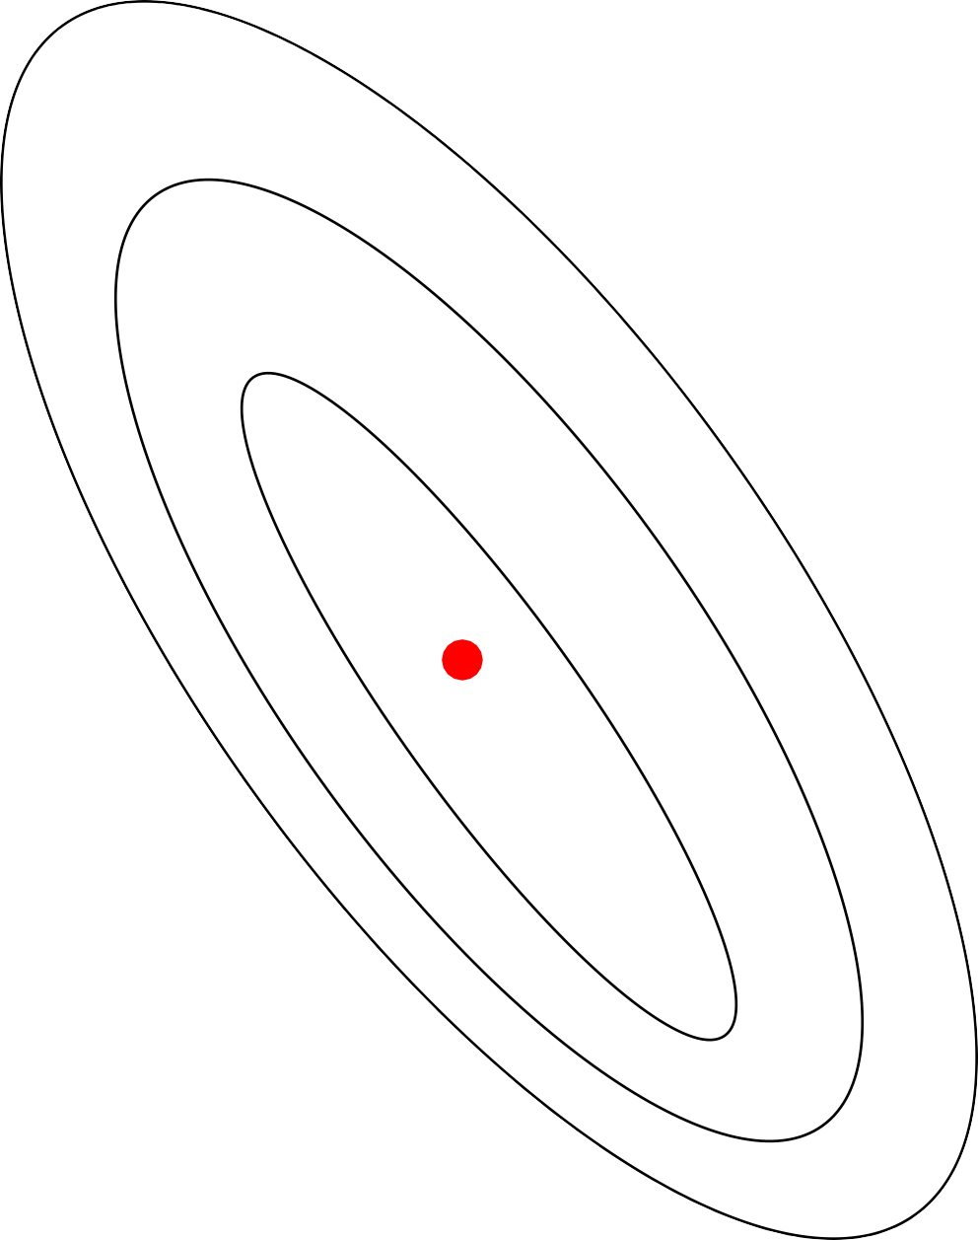
This is what we want

Slide 11
This is what we get
Ho and Ané, 2014

Slide 12
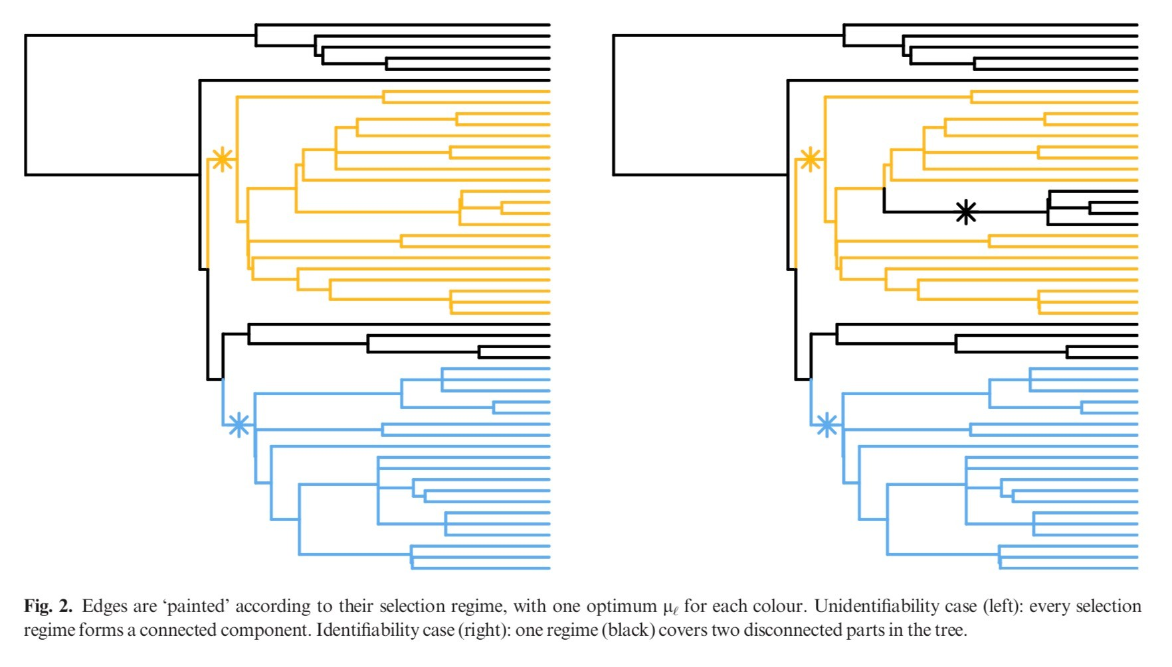
Ho and Ané, 2014

Slide 13
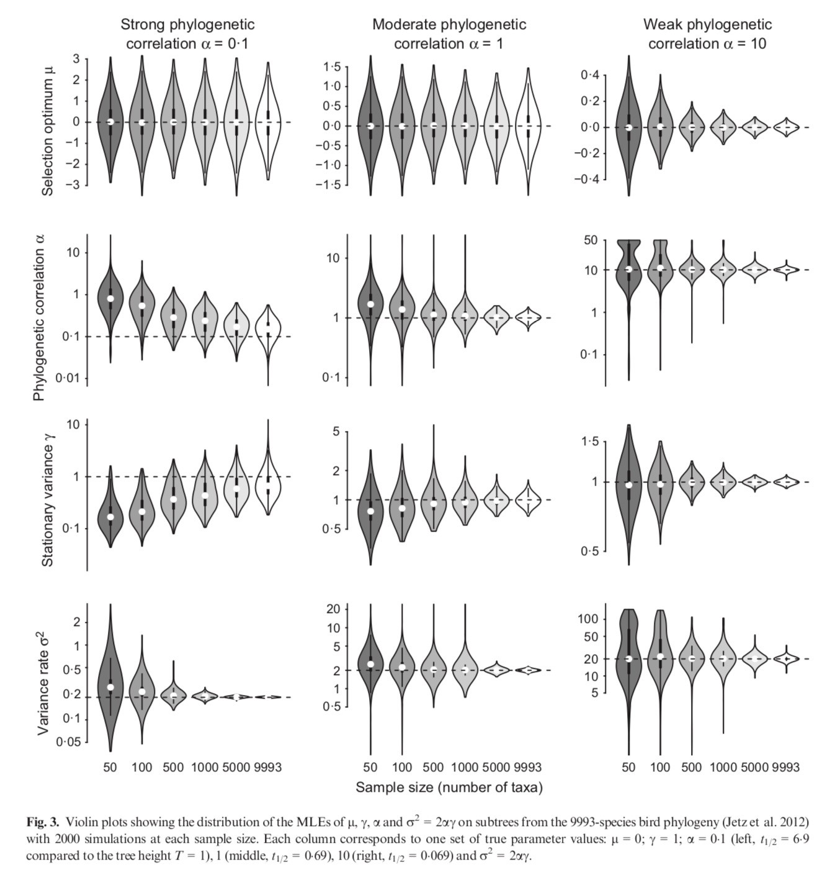
50
9993
50
9993
50
9
993
Ho and Ané, 2014

Slide 14
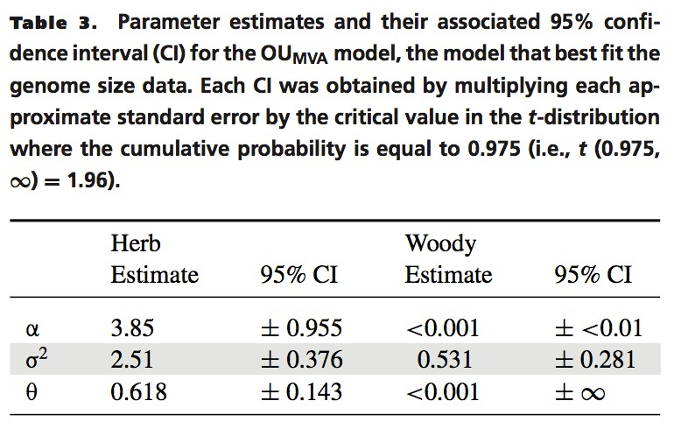
Beaulieu, Jhwueng, Boettiger, O'Meara 2012

Slide 15
Picking models

Slide 16
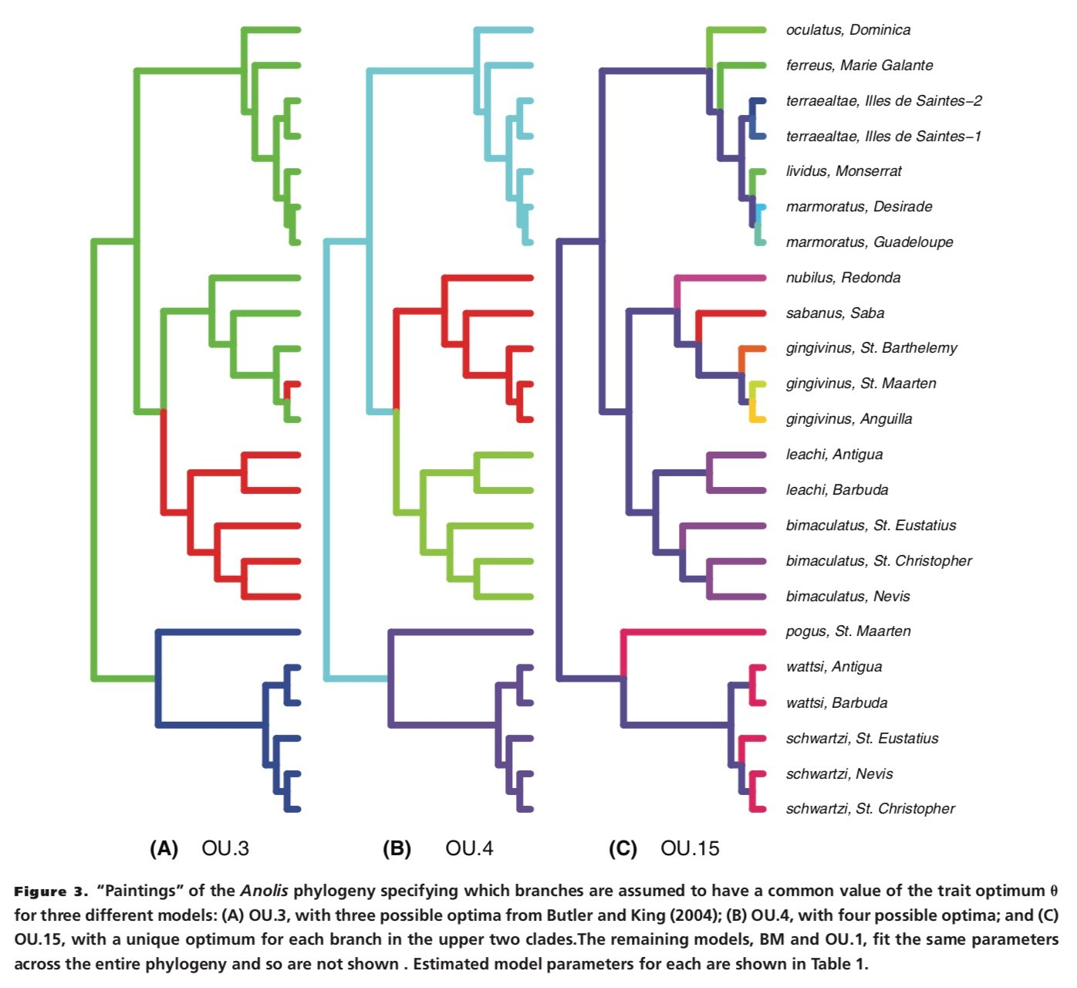
Boettiger, Coop, & Ralph 2012

Slide 17
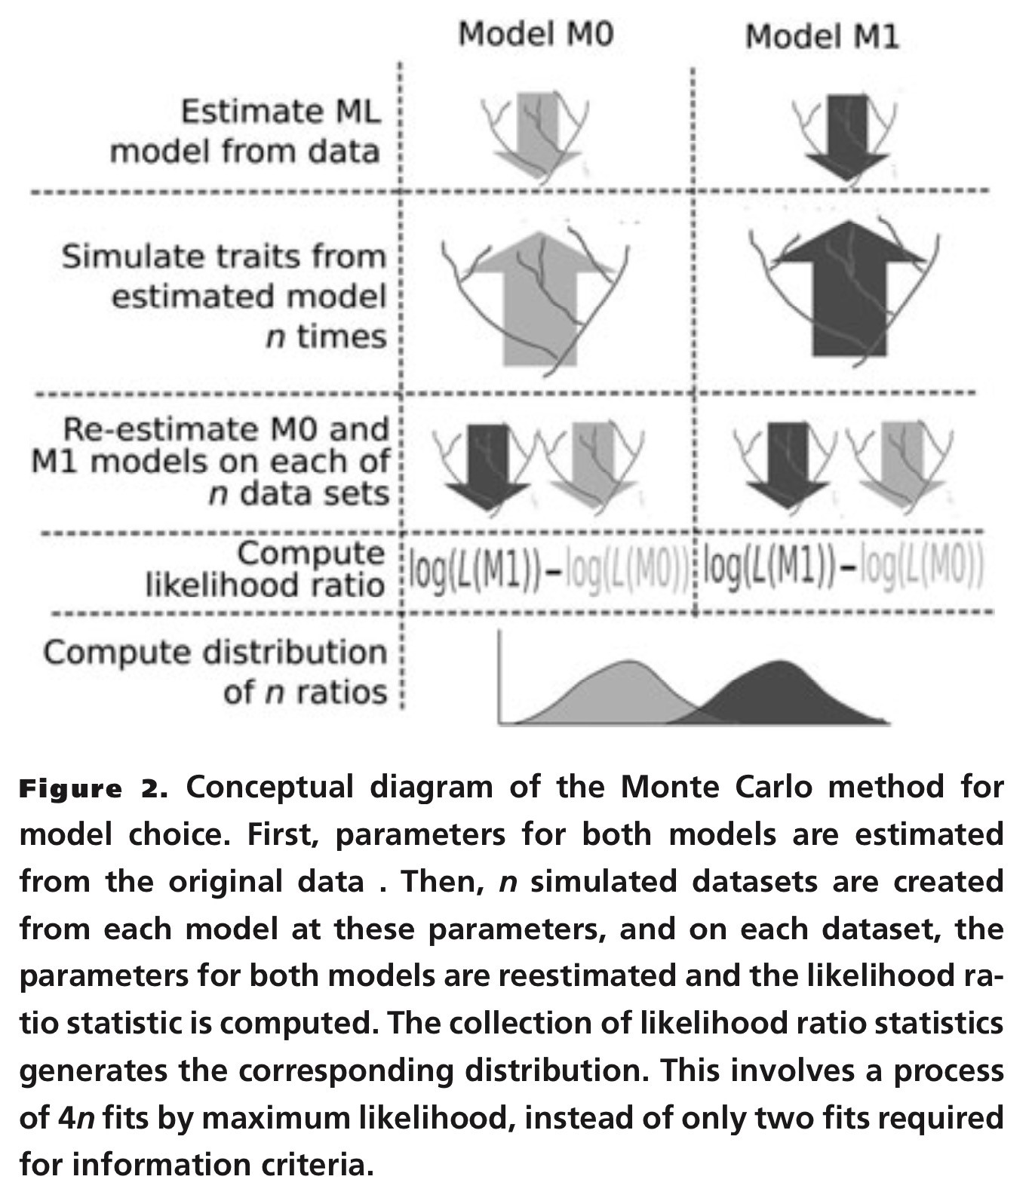
Boettiger, Coop, & Ralph 2012

Slide 18
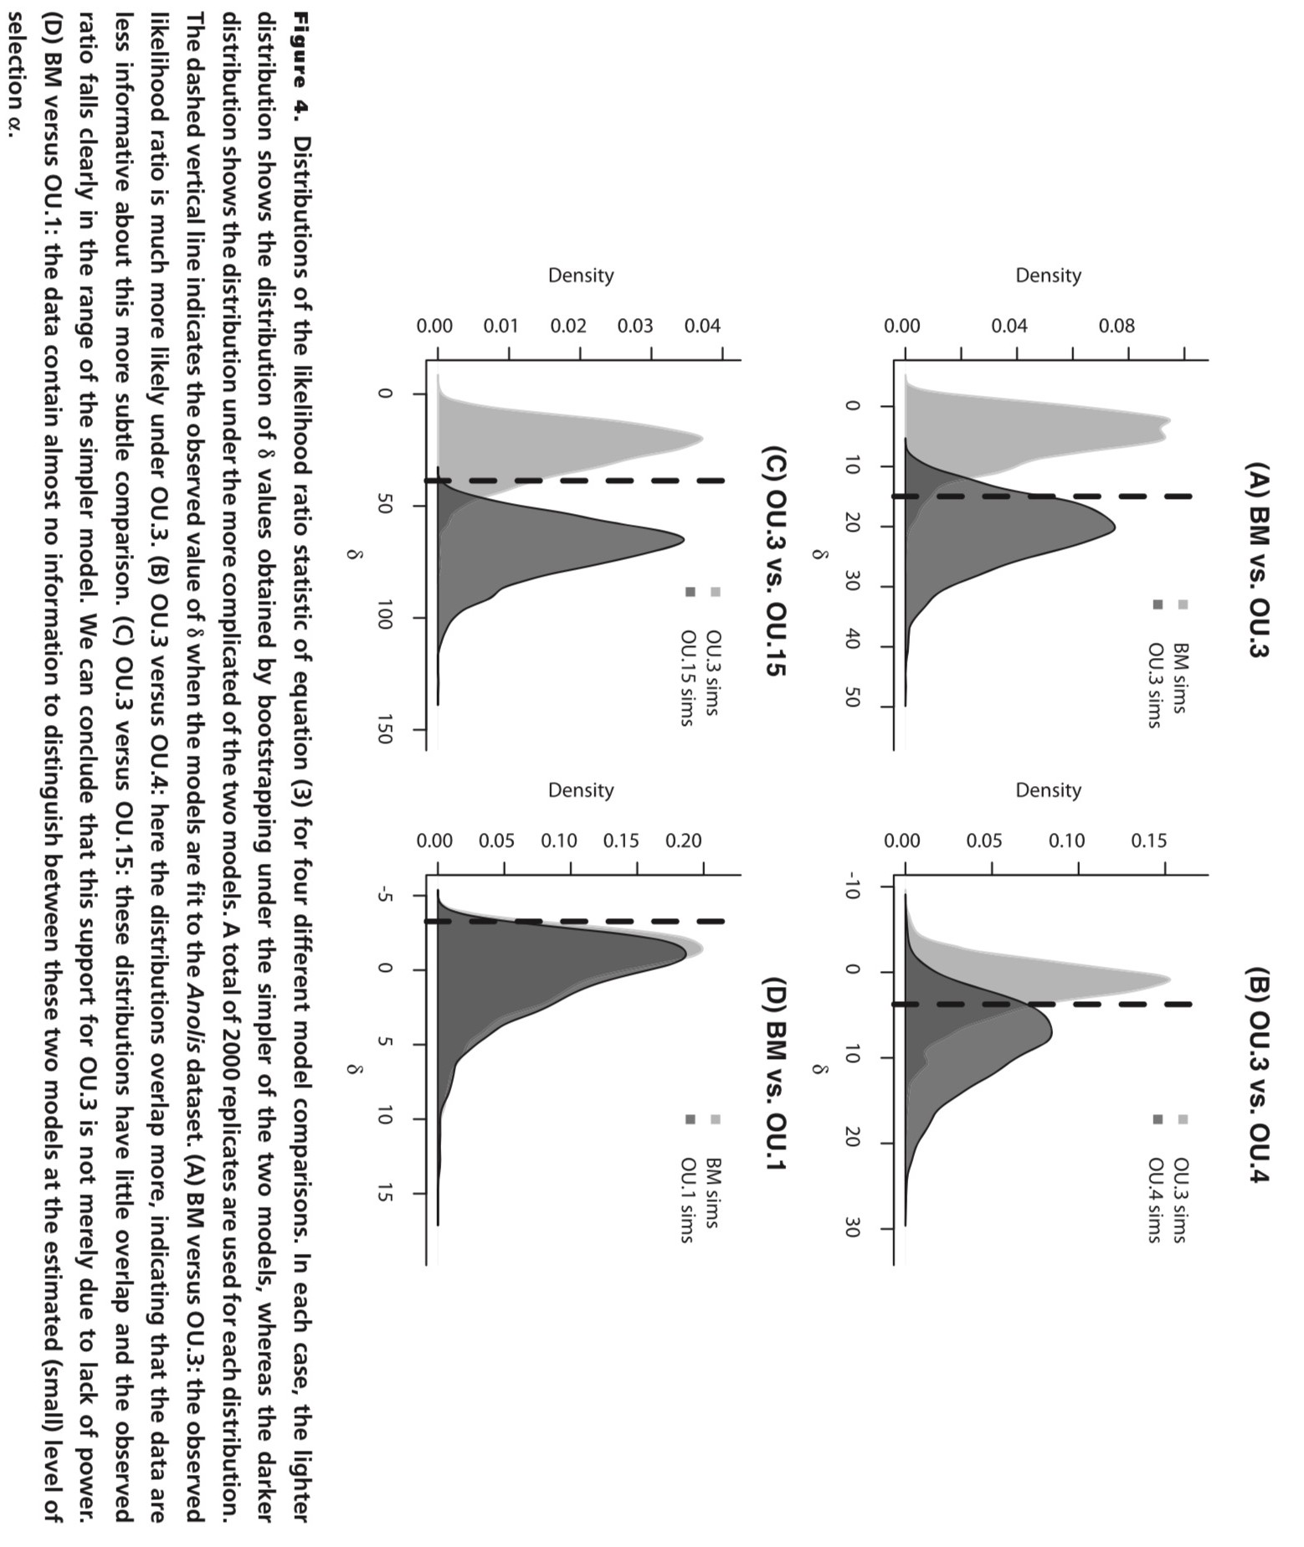
Boettiger, Coop, & Ralph 2012

Slide 19
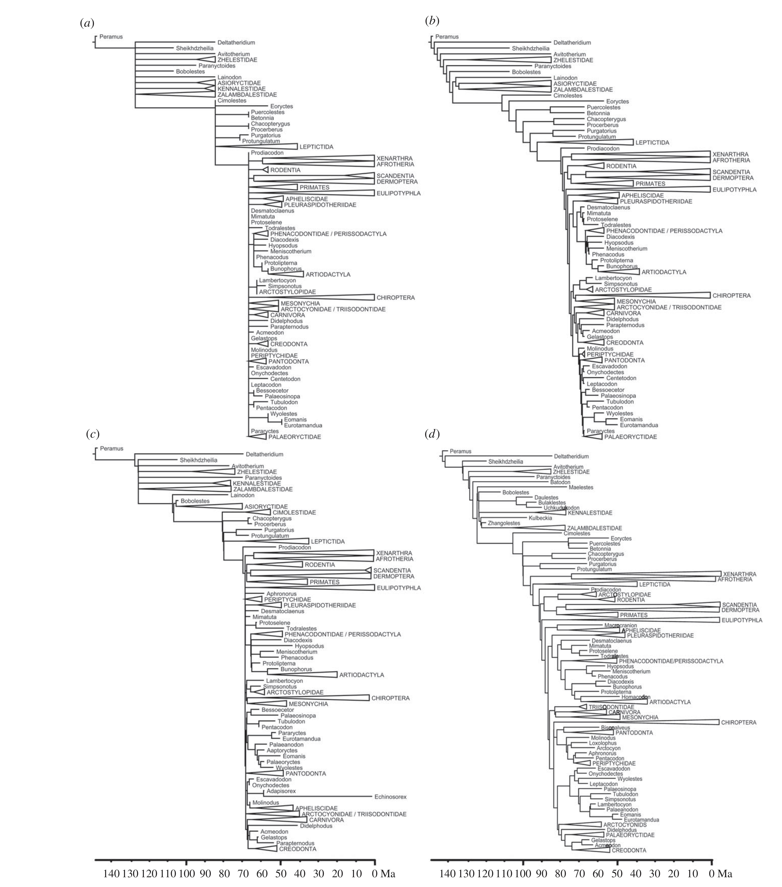
Minimum age dating
Equal branch sharing
Halliday & Goswami 2016
cal3
Fossilized birth-death

Slide 20
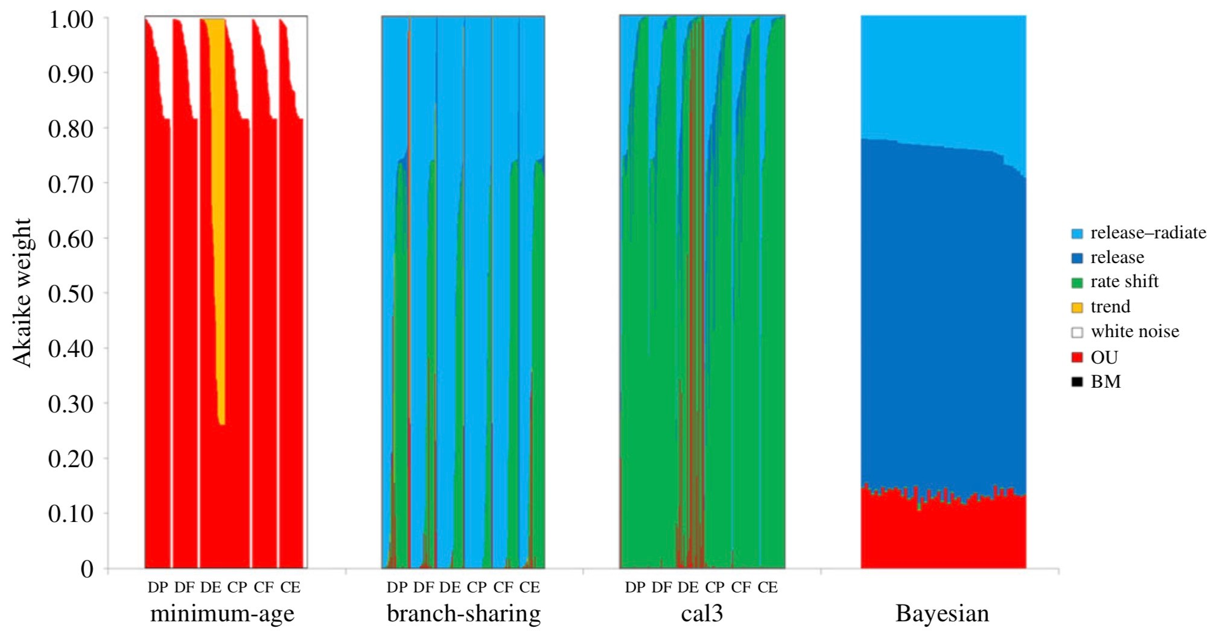
Release or relHere, we fit models of body mass evolution onto dated phylogenies of Cretaceous and Palaeogene mammals, comparing the effect of dating method on interpretation of evolutionary model. Among traditional palaeontological dating approaches, an Ornstein–Uhlenbeck model with high alpha parameters is recovered as best-fitting when minimum-age dating is used, while branch-sharing methods are highly sensitive to topology.
ease–radiate models are preferred when Bayesian fossilized birth–death method is used, but when using stochastic cal3 dating of trees, a model of increased evolutionary rate without a release in constraint at the Cretaceous–Palaeogene boundary has highest support.
Halliday & Goswami 2016

Slide 21
Model adequacy

Slide 22




I observe: 112121221313121
Model A
Model B

Slide 23
I observe: 112121221313121
Model A: Prob of data = likelihood = (1/6)¹⁵ = 2.1e-12 NegLnL = 26.9
Model B: Prob of data = likelihood = (1/8)¹⁵ = 2.8e-14 NegLnL = 31.9

Slide 24
I observe: 112121221313121
Model A
Model B
I’ve told you that simulating data is one way to see if a model is adequate. Talk to your neighbors about what this could mean in this case. Code it up, run it.
See what you find.

Slide 25
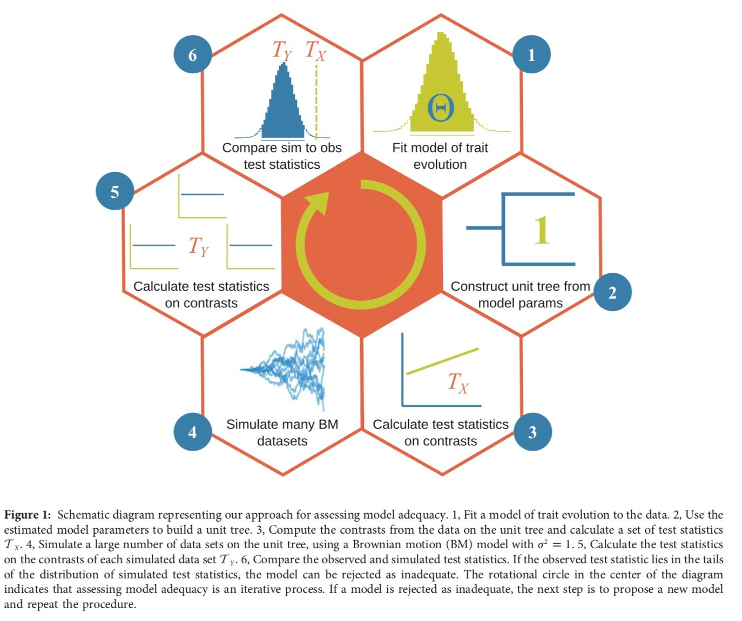
Pennell, FitzJohn, Cornwell, Harmon 2015

Slide 26
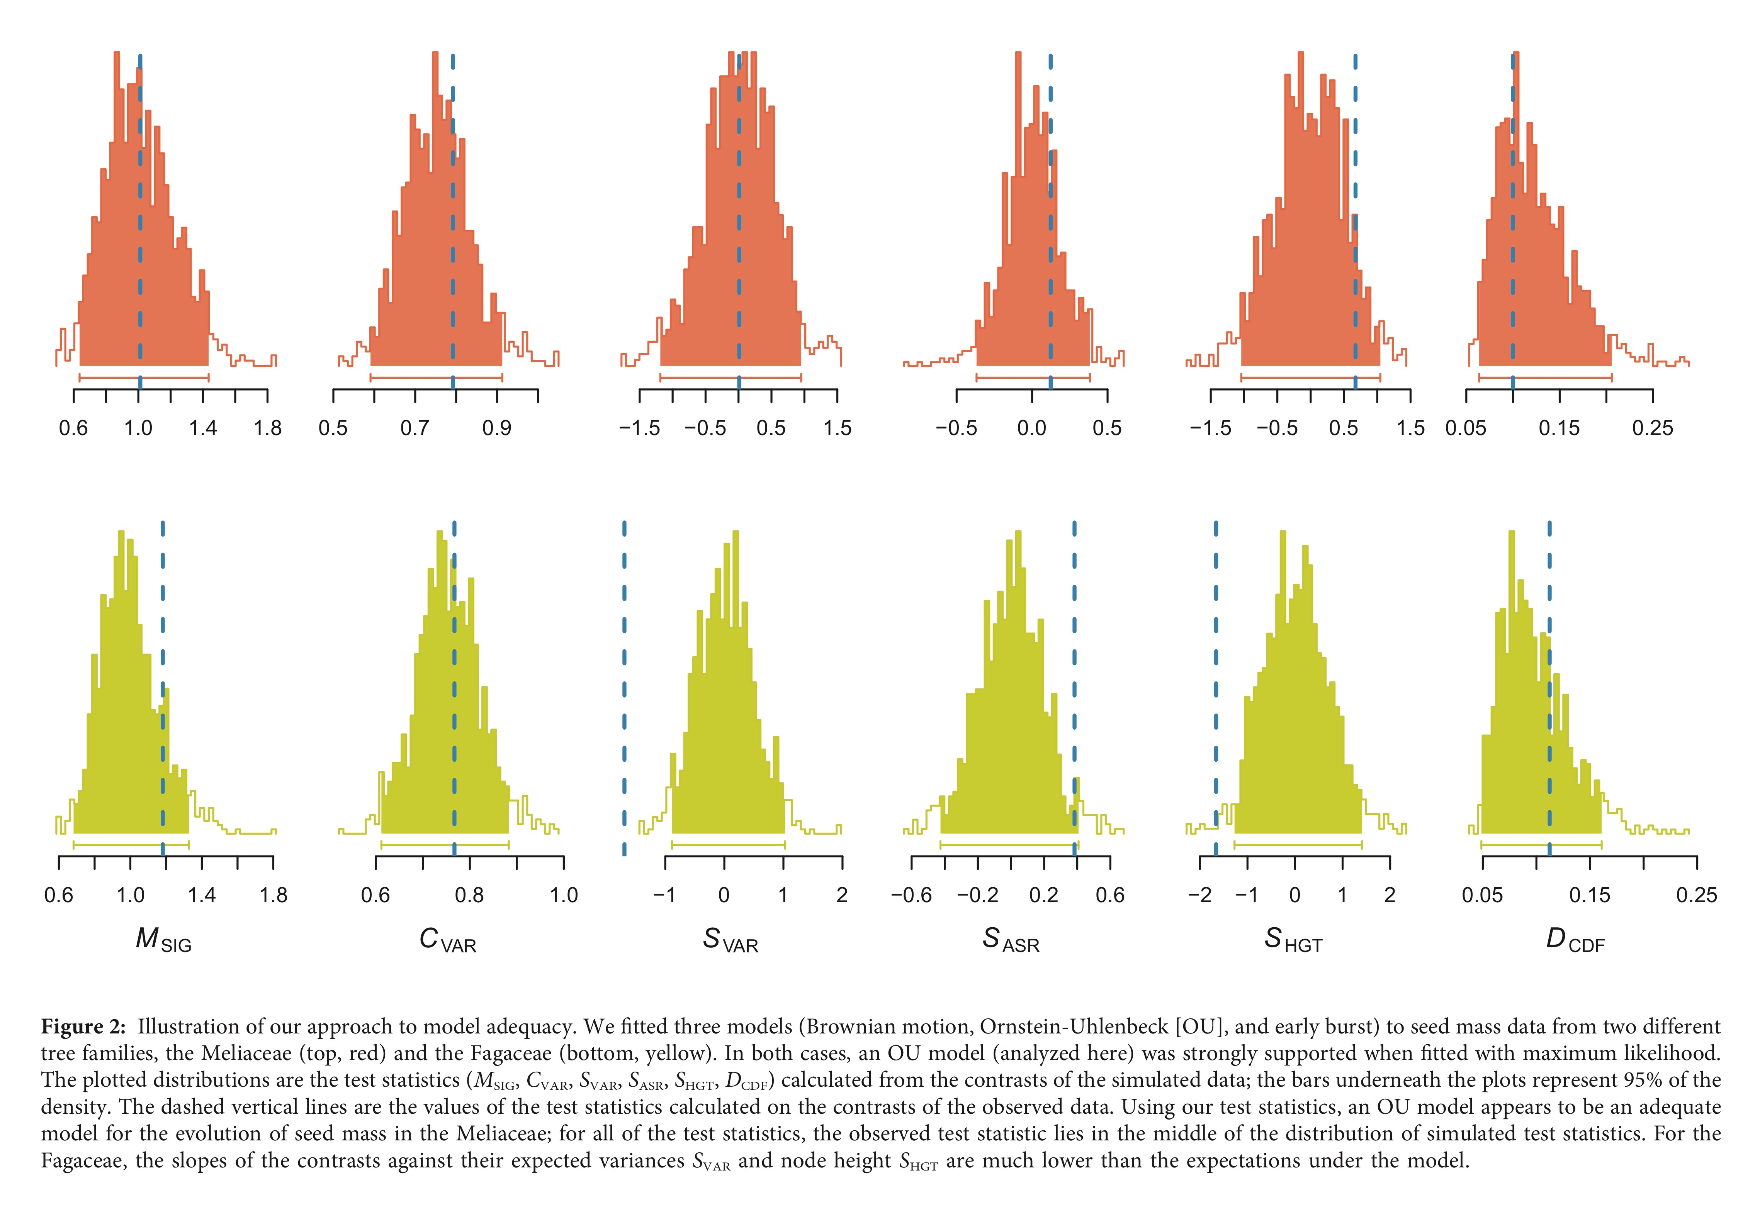
Pennell, FitzJohn, Cornwell, Harmon 2015

Slide 27
What would you do if you find your model is inadequate? Ideally, make a better model. What if you can’t? Should we #JustSayNo and not continue, or #BeBest with the models we have?
What would you do if you find your results depend on dating or some other aspect of your tree?
What would you do if your regimes are arranged such that there’s not enough information to estimate optima?

